Slide 1



PROGRESS REGIONAL ONLINE MEETING
Financing climate resilient agriculture:
Case of Ukraine
Dr. Yevhen Bublyk and Dr. Oleksandr Diachuk
Institute for Economics and Forecasting of the National Academy of Sciences of Ukraine
Regional project „Promoting Green Deal Readiness in the Eastern Partnership Countries (PROGRESS)/EU4ClimateResilience”, funded by the Federal Ministry for the Environment, Climate Action, Nature Conservation and Nuclear Safety (BMUKN) through the International Climate Initiative (IKI), implemented by the Consortium of organizations under the lead of Deutsche Gesellschaft für Internationale Zusammenarbeit (GIZ) GmbH, the Organisation for Economic Cooperation and Development (OECD), a State Institution of the Institute for Economic Research and Forecasting of the National Academy of Sciences of Ukraine (IEF).
10 December 2025
Online
EU&EaP Countries

Slide 2
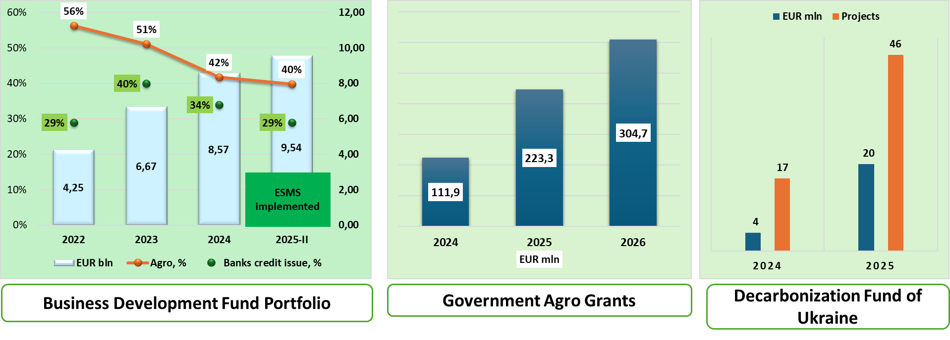
Review of climate-related finance instruments available in Ukraine:
Public/Concessional Finance

Slide 3
Review of climate-related finance instruments available in Ukraine:
Private & Blended Finance
BANKING SECTOR
Agro loans portfolio – 3.2 EUR bln
14% of the total bank loan portfolio
Climate-related bank products are mostly:
under the BDF program
energy efficiency related
IFIs partners programs
GREEN BONDS
Adopted in 2021
Two issues totaling 1.2 EUR bln in 2021
The Green Taxonomy is not yet developed
BLENDED FINANCE
Partial Credit Guarantee Fund in Agriculture (risk-sharing)
Export Credit Agency (risk-sharing & investment insurance)
IFIs risk-sharing programs
State Decarbonization Fund (revolving & concessional lending)
Public Investment Management framework (DREAM)

Slide 4
Review of climate-related finance instruments available in Ukraine:
Next steps :
Strengthen government institutional capacity for developing and implementation of climate- related finance regulation & infrastructure by establishing a governmental interagency coordination body
Develop the National Green Taxonomy with transitional sectoral criteria
Extend specialized targeted loan programs incorporating
the National Green Taxonomy requirements
Improve financial sector regulation to provide positive incentives for private intermediaries to utilize climate-related finance
Develop and implement climate-related insurance mechanisms
….

Slide 5






Deutsche Gesellschaft für Internationale Zusammenarbeit (GIZ)
Martina Kolb / Martina.kolb@giz.de
Regional Environmental Centre for the Caucasus (RECC)
Sophiko Akhobadze / sophiko.akhobadze@rec-caucasus.org
Institute for Economics and Forecasting of the National Academy of Sciences of Ukraine (IEF)
Oleksandr Diachuk / diachuk@ief.org.ua
Organisation for Economic Co-operation and Development (OECD)
Krzysztof Michalak / krzysztof.michalak@oecd.org
Isabella Neuweg / Isabella.neuweg@oecd.org
Fernando Antunez / Fernando.antunez@oecd.org
European Business Association (EBA) Moldova
Mariana Rufa / mariana.rufa@eba.md

Slide 6
Thank you

