Slide 1
Assessing the environmental impacts of agricultural support
OECD analysis, literature findings and synthesis
Jussi Lankoski
OECD Trade and Agriculture Directorate
11 December 2025

Slide 2
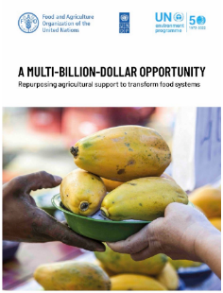
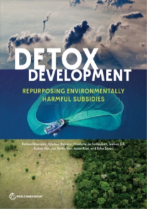
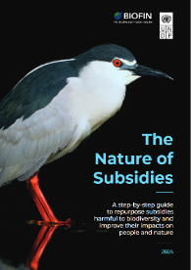
General context
Kunming-Montreal Global Biodiversity Framework has revived the debate on the role of subsidies on the environment:
  For agriculture: “repurposing subsidies” discussed by many reports from international organisations and think tanks
  Finds echo in other fora
    OECD 2022 Agricultural Ministerial Declaration
    COP28 declaration on Food Systems
General principles are agreed but many questions do not make consensus when it comes to practices:
  What support programs can be identified as harmful and should be reformed?
  What forms of beneficial support programs should be ramped up to support the new challenges faced by the agricultural sector?

Slide 3
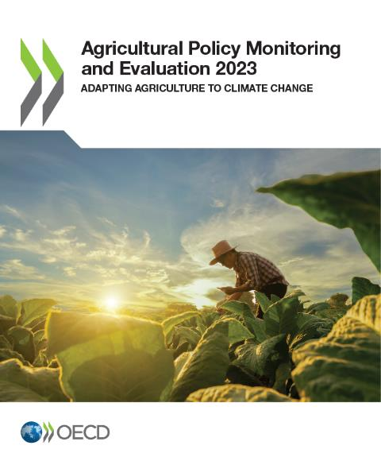
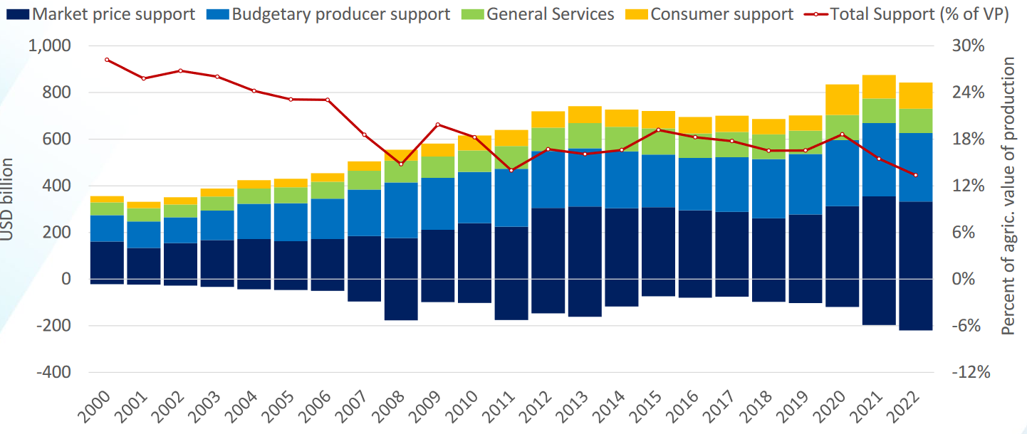
OECD Agricultural Policy Monitoring and Evaluation
>> http://oe.cd/monitoring
Annual report providing
  A qualitative description of agricultural policy changes across the world
  A quantitative estimation of public support to agriculture for producer (PSE), consumer (CSE) and general services
  54 countries covered
  (OECD + EU + 11 emerging countries)
  Coverage of 75% of global
  agricultural value-added
  851 billion USD per year for
  agricultural support in 2020-22
  > 7,500 agricultural support interventions inventoried
3

Slide 4
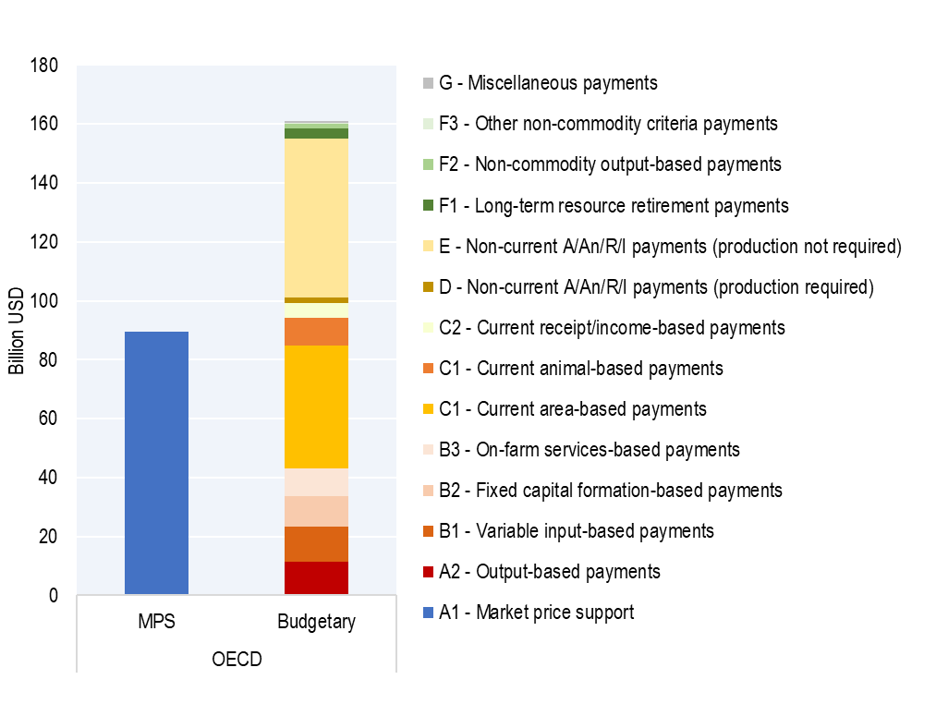
Current structure of support data on agriculture:
Support to producers
Decomposition of OECD producer support estimate (PSE)
by implementation criteria
64%
Based on non-commodity outputs (2%)
Decoupled from current production (22%)
36%
Partly decoupled from production, less market distorting
(30%)
Output-based and variable input-based support (w/o constraints)
Potentially most production and trade distortive support
(45%)
Source: OECD Agricultural Policy Monitoring and Evaluation, average annual support 2019-21.

Slide 5
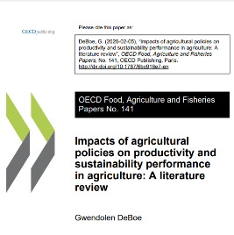
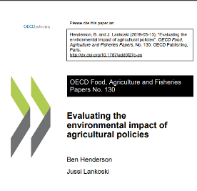
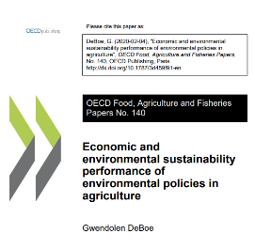
What did past OECD studies show on agriculture?
Literature reviews, farm and sector level modelling and causal data analysis methods at country level show:
  market price support (cat. A1)
  output subsidies (cat. A2)
  variable input subsidies
  without constraints
  (subset of cat. B1)
Most production coupled forms of producer support can be contrasted with least coupled forms of support
  support based on historical entitlements
  without production requirements (cat. E) > neutral
  support to non-commodity outputs (cat. F) > potentially most beneficial
    land retirement (cat. F1)
    environmental features (wetlands, buffer strips, etc.) (cat. F2)
Environmental requirements can improve the outcome
  Input use constraints, cross-compliance conditions
  Agri-environmental payments
Create the strongest price incentives
to increase domestic production using
all available production methods and inputs
Incentivise the use of additional inputs with potentially harmful effects on the environment

Slide 6
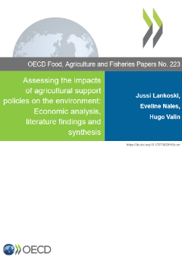
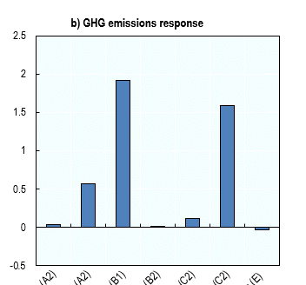
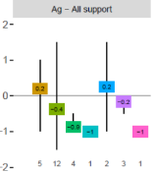
Assessing the impacts of agricultural support policies on the environment
Conceptual framework
Microeconomic theoretical model to understand the main mechanisms associated to incentives
OECD Paper No. 223
Lankoski, Nales and Valin (2025)
Proposed framework and typology
of agricultural support instruments based on potential environmental impacts
Simulation results based on applied CGE model with international market effects
Comparison with other modelling literature
Review of literature findings by type of instrument and environmental dimension
https://dx.doi.org/
10.1787/808f110c-en

Slide 7
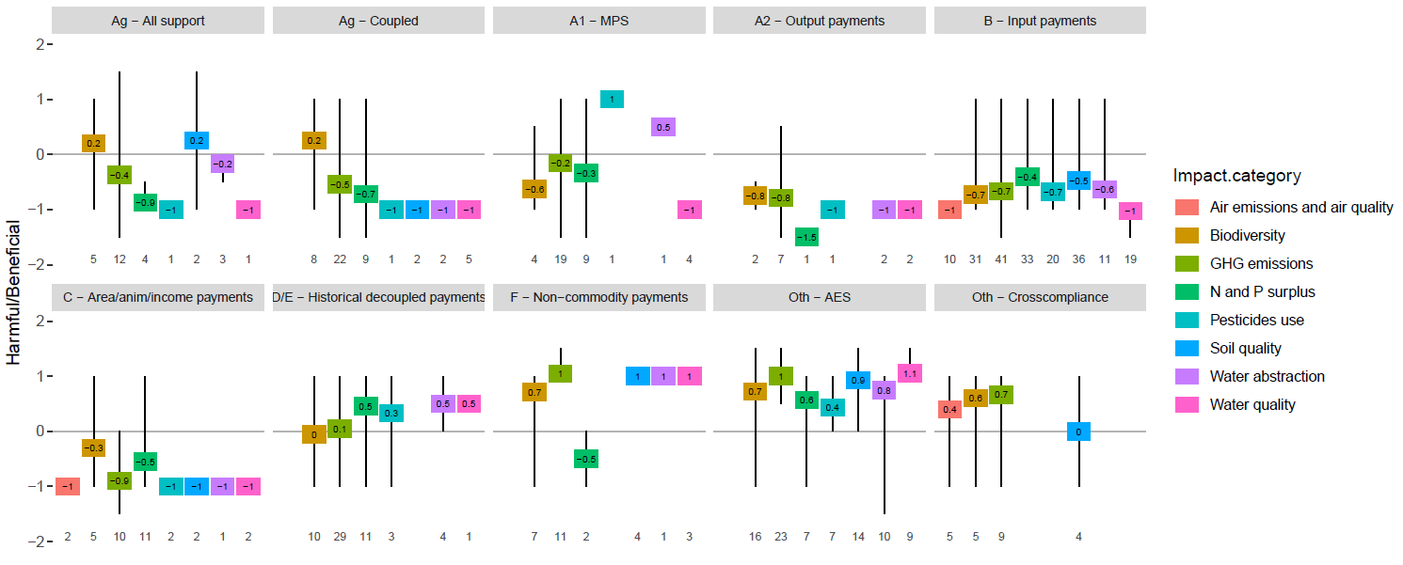
Results: Literature review – main support categories
Literature review based on 85 papers with 607 observations
Beneficial (positive) or harmful (negative) impact score per type of instrument

Slide 8
Synthesis: Two dimensions to determine impacts
Environmental impacts =
Generic characteristics of payments X Contextual elements
Typology around elements such as:
Type of payment in OECD classification
Type of production or input being supported
Environmental conditions tied to payment
(production constraints, cross-compliance, type of agri-environmental payment)
Local characteristics such as:
State of natural resources
Farming local conditions
Environmental and resource policies
International market interactions
Potentially harmful or beneficial > Effectively harmful or beneficial
Notes:
One of the key outcomes of our work is a structured framework that helps to identify the potential environmental harm or benefits of various forms of support measures. This framework integrates:
Generic characteristics of payments: such as instrument category, type of production or input being targeted, and environmental provisions attached to the support – potentially harmful, beneficial or neutral.
And Contextual elements: such as current state of natural resources and farming conditions, as well as, environmental policies – effectively harmful, beneficial or neutral.

Slide 9
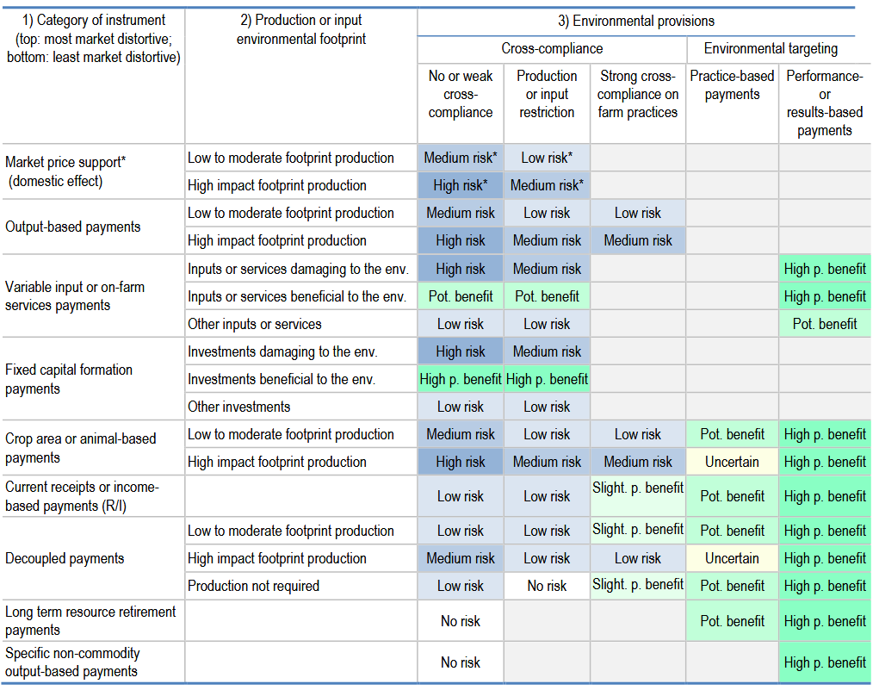
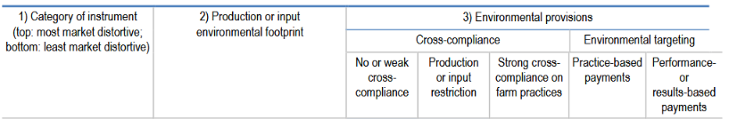
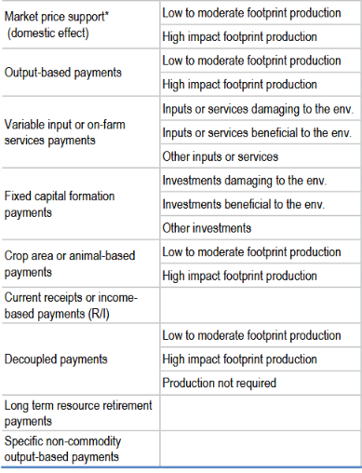
From support category to level of risk/potential benefits
Combination of:
(1) Instrument category
(2) Type of targeted input or production
(3) Environmental provisions

Slide 10
Outcome of more systematic assessment
Most likely to be harmful, or high risk
payments based on output, animal number or area, for production with high environmental footprint
  E.g. low productivity cattle rearing, crop varieties with high water or pesticide requirement
payments to variable input with high damaging potential
  E.g. fertiliser, fossil fuel, feed use, or water use
support to investments into assets worsening environmental impacts
  E.g. groundwater irrigation; livestock barns expansion
with each of these measures exempt from specific form of restriction or environmental provisions
Most likely environmentally beneficial
support reducing consumption of inputs with high environmental damage potential
or increasing those of inputs with high benefit potential, based on performance- or results-based payment criteria;
support to investments into assets with direct environmental benefits
  E.g. renewable energy, biodigesters
performance or results-based agri-environmental payments;
payments for natural resource retirement from production – including environmentally sensitive land
payments for environmental goods and services on agricultural land.

Slide 11
Thank you!

