Slide 1
PROGRESS Technical Workshop
Financing climate resilient agriculture: Why we need it, what instruments exist and how to scale them up
PROGRESS Regional Online Meeting
10 and 11 December 2025, 9:00 – 12:00 (Paris/Brussels time)

Slide 2
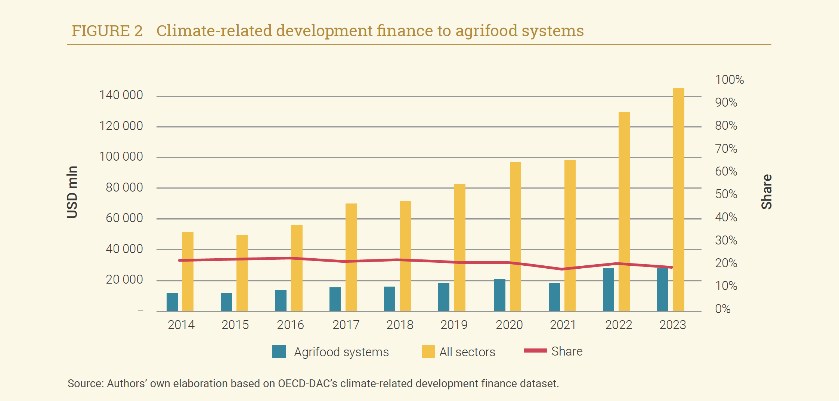
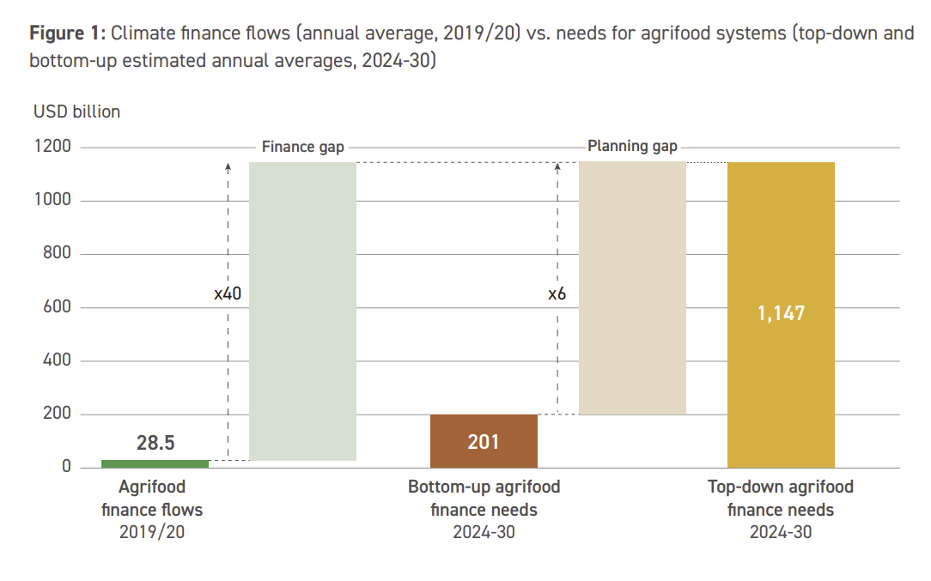
Size of the challenge: Adaptation and agrifood finance gap
Climate-related development finance to agrifood systems
Climate finance flows (annual average 2019/20 versus needs for agrifood systems (annual averages, 2024-2030)
Source: Galbiati et al., 2025.
Source: CPI & FAO, 2025.

Slide 3
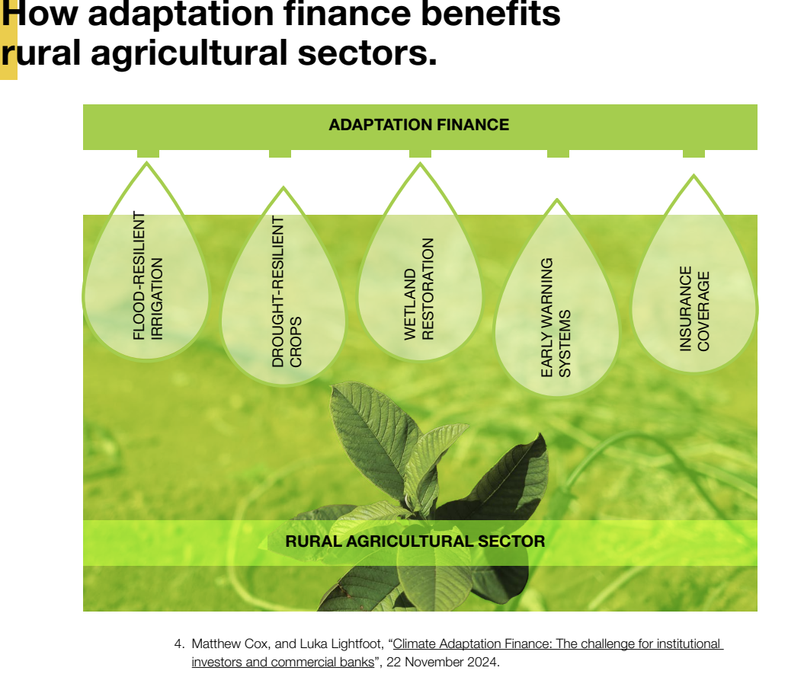
How adaptation finance benefits rural agricultural sectors
Source: CPI & FAO, 2025.

Slide 4



Typical adaptation finance instruments, their objectives and investment examples
Objective | Instruments | Investment examples
Fund public goods/seed funding | Grants | Climate-smart farming
Scale up projects | Concessional loans | Resilient agriculture
Unlock private capital through de-risking | Blended finance, guarantees | Irrigation/value chains
Mobilize market-based expansion (private ventures through capital markets and ownership) | Equity, resilience bonds, insurance, biodiversity credits | Agri-tech, water-saving, infrastructure
Free up fiscal space for climate action | Debt-for-climate or nature swaps | Coastal zone protection

Slide 5
Progress in Armenia, Azerbaijan and Moldova

Slide 6
Climate Risks and Vulnerability Overview by Country
Country | Main Climate Risks | Examples of vulnerability and context
Armenia | Frost, drought, floods, hail, soil erosion | High water dependence in agriculture (around 87% of total water use) (AUA, 2024). The Ararat Plain is particularly vulnerable (OECD, 2025). Agriculture is highly fragmented, with 90% of farms smaller than three hectares (FAO, 2022).
Azerbaijan | Droughts, heatwaves, water scarcity | Obsolete irrigation, only 2 irrigations/season vs. 6–7 recommended; 42% of land affected by erosion/salinization (Mammadov, 2022);
Moldova | Frosts, floods, prolonged droughts, heatwaves, hail | Small farmers (98% of farms) least prepared for adaptation; average annual climate losses: USD 164 million (1.3% of GDP) (World Bank, 2024); . High informality in agriculture (over 60% of workers in 2024) (EC, 2024).

Slide 7
Public Finance
Country | Ag Budget | Key Mechanisms | Adaptation Orientation
Armenia | AMD 45 billion (USD 115M) in 2024 60% allocated to AMP | 0% interest loans (AMD 3–50M → USD 7,500–125,000). Subsidised leasing at 2% interest. | AMP allocates 68.6% to intensive horticulture and 6.7% to irrigation/anti-hail systems.
Azerbaijan | AZN 1.1 billion (USD 1.05B) in 2024. 40% in direct subsidies | AKIA soft loans (5–7% interest). State-subsidised leasing: 40–60% coverage; interest fully paid by government. | Subsidies: AZN 60/ha (~USD 35/ha) for complex irrigation; AZN 400–12,000/ha (~USD 235–7,000) for modern orchards.
Moldova | MDL 1.54 billion NFARD (USD 91M 2024) | Livada Moldovei: EUR 120M (~USD 131M) line of credit; 10-year loans at 2.8–4.9% interest. Agricultural Credit Facility (ACF): 5.1% fixed + up to 30% grant component. | Supports drip irrigation, anti-frost, anti-hail, post-harvest and storage infrastructure.
Notes:
AMP: Agriculture Modernization Programme
NFARD: National Fund for Agriculture and Rural Development

Slide 8
Private Finance and Agricultural Insurance
Instrument | Armenia (ARM) | Azerbaijan (AZE) | Moldova (MDA)
Private Finance | Commercial credit growth, but heavily reliant on public subsidy or concessional IFI funds (e.g., GAF-AF). | Limited due to high interest rates and collateral requirements. Smallholders rely on self-financing/informal channels. | Agricultural credit is only 7.3% of total bank loans. IFI funds (EBRD, EIB) mainly channeled through commercial banks.
Subsidized Agricultural Insurance | Yes, public-private scheme. Temporary subsidy up to 70–80%. | Yes, public-private scheme. Subsidy 50% of premium. Droughts excluded. | Yes, public-private scheme. Subsidy 70% of premium. Low uptake.
Green Taxonomy/Bonds | Green Taxonomy approved (2025). Climate-smart agriculture is defined. Agriculture as a priority sector.. | Green Taxonomy introduced (2024). First green bond issued (Unibank, 2024). | Agricultural policies align with EU. Development of sustainable finance framework (roadmap, taxonomy, etc.)
Access for Smallholders | Unequal; large agribusinesses capture a disproportionate share. | Unequal; barriers include high collateral and limited financial outreach. | Unequal; subsidy procedures often favor larger, connected farmers.

Slide 9
Low Financial Resilience
- Small farmers face high interest rates, strict collateral requirements, and limited access to formal finance → reliance on self-financing and informal loans.
Weak Agricultural Insurance
- Underdeveloped markets with very low coverage (Moldova: ~1% of insured farmland).
- Climate risks often excluded (e.g., drought in AZE).
- Armenia relies on a temporary state-backed reinsurer due to climate-related losses.
Aging Infrastructure
- Water scarcity + degraded irrigation systems remain major constraints.
Misaligned Public Financing
- Budgets focus on direct subsidies (fuel, fertilizers) rather than long-term climate-resilient investments.
- Limited funding for irrigation, soil protection, and adaptation infrastructure.
Challenges across all countries

Slide 10
Recommendations per country
Theme | Armenia (ARM) | Azerbaijan (AZE) | Moldova (MOL)
1. Public Finance | Integrate climate-conditionality into all public support (loans, grants, leasing). Strengthen governance through a permanent inter-ministerial climate–finance working group. | Rebalance subsidies toward climate-smart practices. Increase investment in resilient infrastructure (irrigation modernization, soil protection). | Improve the management of public support programmes to align them with EU requirements and explicitly integrate adaptation criteria in project appraisal systems. Provide public support and fiscal incentives for testing, demonstration and adoption of new adaptation technologies to distribute risks.
2. Risk Management and Insurance | Establish a national climate risk pool to stabilize agricultural insurance. Expand coverage to all major climate risks and incentivize farmers using risk-reducing practices. | Make insurance more preventive (ex-ante), based on climate data and forecasts. Expand coverage to key risks (especially drought). | Consider the introduction of index-based insurance as a more realistic and objective way of monitoring and estimating risks. Estimate the costs for the public and private sector of this insurance practice and develop relevant regulations.
3. Private Sector and Financial Inclusion | Expand blended-finance schemes to reduce risk for lending to small farmers and cooperatives. Promote green/sustainability bonds targeted at climate-adaptation investments. | Promote green finance tools (warehouse receipts, green bonds, concessional loans). Ensure instruments target small farmers, women and youth. | Improve blended finance and de-risking instruments to incentivise commercial financers to offer lending products which better fit the needs of small farmers and agribusinesses. Better monitor the impact of banks’ agricultural lending and improve reporting transparency.
4. Capacity, Advisory Services and Coordination | Strengthen advisory services, certification, storage and logistics aligned with export markets. Prioritize modernization and monitoring of irrigation systems. | Align donor projects with national plans (NAP). Expand farmer training, digital tools and climate-smart extension services. | Strengthen agricultural cooperatives and credit unions to provide better advisory and financial services to their members. Provide support/create a facility to help small farmers and agribusinesses to identify needed solutions and technologies and prepare projects that can obtain financing.

Slide 11
Good Practices in Mobilising Finance for Climate-Resilient Agriculture

Slide 12
Why this matters:
⚠️ Significant financing gap for climate adaptation in agriculture
🌱 Wide range of interventions, but limited evidence on effectiveness
Our Review Objectives:
📋 Identify and categorize policy instruments for financing climate-resilient agriculture in OECD and non-OECD countries
💰 Assess impact on public and private financial flows
✅ Evaluate effectiveness in achieving resilience and agri-environmental outcomes
🌍 Explore contextual factors: geography, governance, agricultural systems
Any policy or regulatory intervention aimed at increasing public or private financing for climate-resilient agriculture:
Subsidies
Green bonds
Insurance schemes
Climate funds
Public-private partnerships
Credit guarantees
12

Slide 13
Overview of financing mechanisms for climate-resilient agriculture
Type | Mechanisms | Strengths | Key Challenges
Public (domestic) | Grants, concessional loans, subsidies, guarantees, PES | Government can target vulnerable farmers, set policy environment | Long payback, budget constraints, risk of misallocation
Private | Commercial loans, equity, blended finance, insurance | Mobilises large capital, innovation potential | High risk perception, low returns, complex measurement
International/Coop. | Multilateral funds, blended facilities, carbon/PES markets | Global scale, technical assistance, large mobilisation potential | Complexity, coordination, ensuring reach to smallholders, measuring outcomes

Slide 14
Existing evaluations of agricultural and environmental interventions (Annex B of Scoping Note)
Evidence shows that timely access to finance, capacity-building, and targeted incentives are critical for adoption of climate-resilient agricultural practices
Bangladesh Flexible Loan Contracts for Microentrepreneurs : Flexible loan repayment for microentrepreneurs enabled riskier, higher-return investments with lower default rates.
Kenya Agricultural Microinsurance for Sugar Cane Farmers : Delaying insurance premium payments for sugarcane farmers increased insurance uptake.
Kenya Innovative Finance for Technology Adoption : Well-timed credit for maize storage allowed farmers to store more and sell later at higher prices.
Uganda Testing the Effectiveness of Payments for Ecosystem Services to Enhance Conservation : PES reduced forest loss from 9% to 4%, cutting carbon emissions at USD 0.46 per ton.
Malawi Improving the Allocation of Land Use Subsidies Through Self-Selection : Self-selection for tree planting subsidies improved tree survival and reduced negative side effects.
Niger Are Rainwater Harvesting Techniques Profitable for Small-Scale Farmers: Training on rainwater harvesting significantly increased adoption; conditional or unconditional cash transfers alone had no effect.
Source: Abdul Latif Jameel Poverty Action Lab (J-PAL), as summarized in OECD Scoping Note, Annex B.

Slide 15
Possible list of case studies
AGRI3 Fund (Rabobank and UNEP) | Kenya’s “Green Bond” supporting sustainable agribusiness
Brazil’s ABC+ Programme for low-carbon agriculture | Mexico’s Green Resilience Bond
Costa Rica’s PES programme applied to agroforestry | Nicaragua’s Incofin Investment Management (investment fund)
EU CAP eco-schemes and agri-environment-climate measures (AECMs) | The &Green Fund (blended finance for deforestation-free agriculture)
France’s PES programme and biodiversity credit scheme | Switzerland’s ecological compensation payments

Slide 16
Contact
Countries
Deutsche Gesellschaft für Internationale Zusammenarbeit (GIZ)
Martina Kolb / Martina.kolb@giz.de
Regional Environmental Centre for the Caucasus (RECC)
Sophiko Akhobadze / sophiko.akhobadze@rec-caucasus.org
Institute for Economics and Forecasting of the National Academy of Sciences of Ukraine (IEF)
Oleksandr Diachuk / diachuk@ief.org.ua
Organisation for Economic Co-operation and Development (OECD)
Krzysztof Michalak / krzysztof.michalak@oecd.org
Isabella Neuweg / Isabella.neuweg@oecd.org
Fernando Antunez / Fernando.antunez@oecd.org
European Business Association (EBA) Moldova
Mariana Rufa / mariana.rufa@eba.md
16

